Slide 1
Welfare reforms and professional workers amongst new challenges and good practices: the case of the Italian “Casse di Previdenza”
Andrea Ciarini
Sapienza University of Rome, Department of Social and Economic Sciences
andrea.ciarini@uniroma1.it

Slide 2
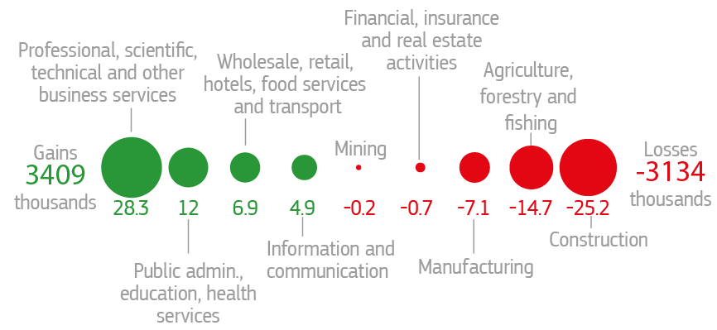
The economic crisis and the labour market in Europe
The employment trends in the EU by economic activities, Years 2008-2015, (%)
Losers and winners in the transition to the knowledge society, Years 2010-2014
Source: our elaboration on Eurostat labour Force Survey
Source: Oecd 2016

Slide 3
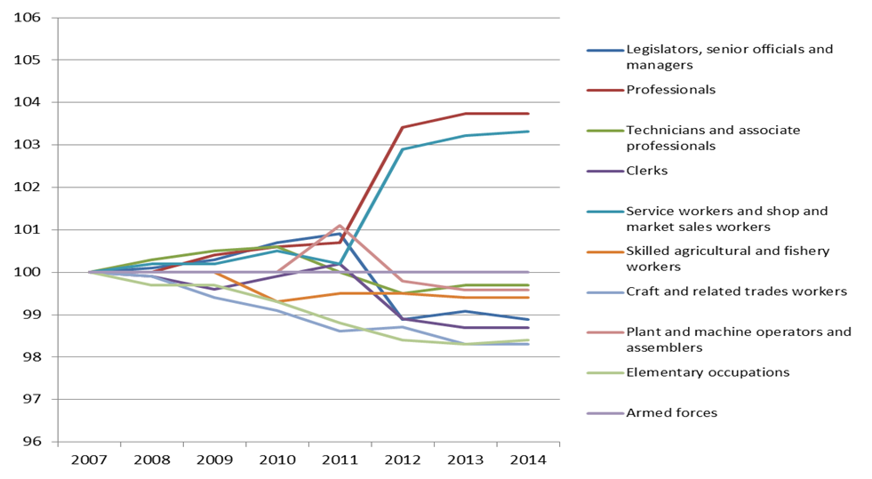
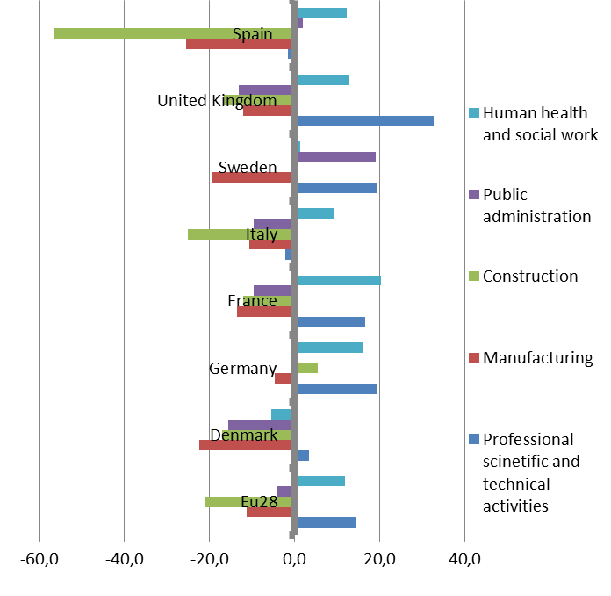
Beyond the impacts of the economic crisis, the transition to the service economy and the effects of technology “revolution” are contributing to reinforce a new (and more profound?) dualism between high-skilled and low-skilled jobs;
Losers and winners in the transition to the knowledge society, Years 2007-2014
The employment trends by economic actvities in some European countries, Years Years 2008-2015, (%)
Source: Eurostat
Source: Eurostat- Labour Force Survey

Slide 4
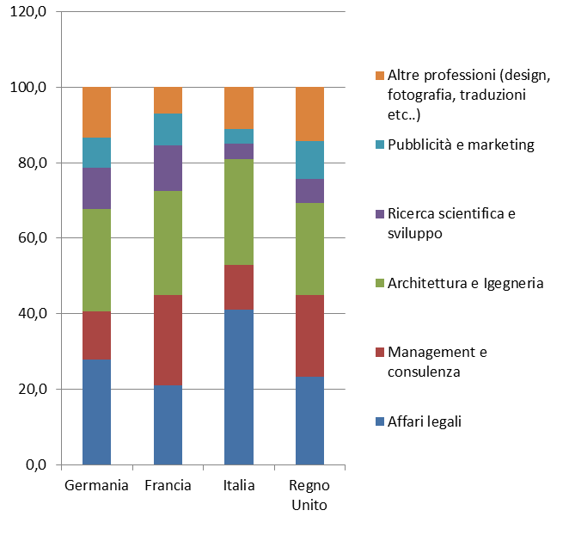
Despite the crisis, the number of professionals in Italy continues to grow Growing numbers, but heavily concentrated in some important areas – legal affairs, architecture and engineering, and even the medical profession (500 thousand in Italy) – whose income has been affected by the negative effects of the crisis, particularly among young people, women and the residents of the southern regions There are comparatively few professionals working in the advanced tertiary sector, consulting and management:

Slide 5
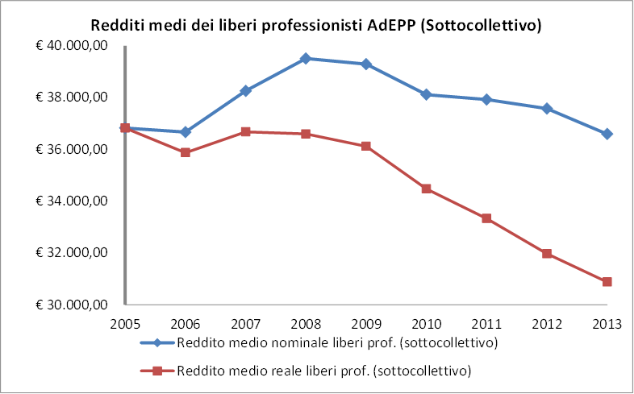
Professionals’ yearly incomes in Italy, years 2005-2013, ass. val.
Source: AdEPP

Slide 6
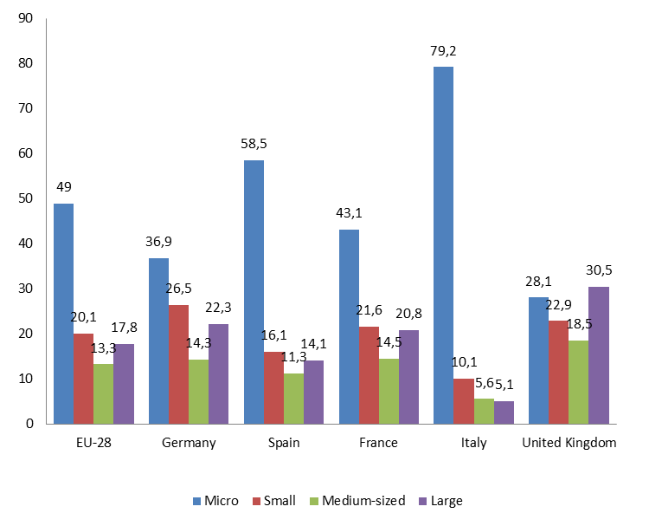
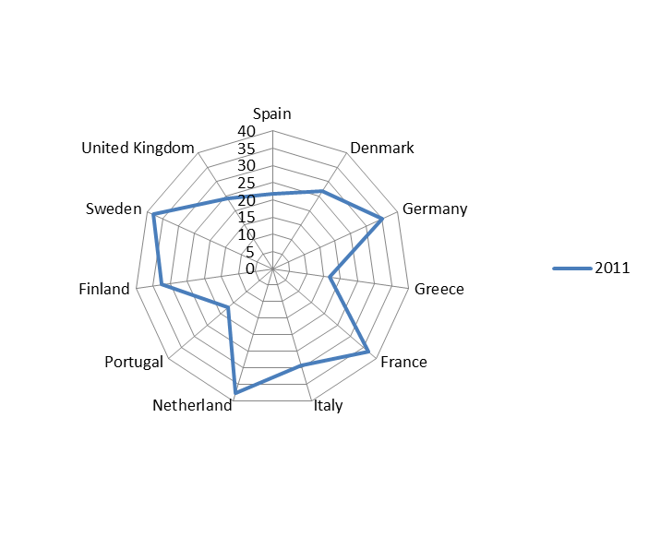
Low added value and low productivity are factors that adversely affect professional labour in Italy. These factors result in a productive structure characterized by a low propensity to aggregate in large companies, versus a strong component of micro-enterprises. In Italy, as many as 79% of those employed in professional services work for micro-enterprises. Other more liberalized countries have higher productivity rates and more employees working for large companies (UK). Less regulation favours aggregation amongst professionals, with cascading effects of a higher rate of productivity growth?
The distribution of professional workers in the labour market by size of company in some European countries, Year 2012, (%)
The added value of professional work in some European countries, Year 2011

Slide 7
The self-employed and professionals during the crisis. Labour productivity, organizational innovations and new welfare
Self-employment and professional work during the crisis: Why (and how) a new social contract is necessary
An increasing risks of social vulnerability and the lack of “dedicated” social protections schemes towards new social risks
At a European level, the Entrepreneurship 2020 Action Plan (2013) and the Working Group "Bolstering the Business of Liberal Professions” (2014): support for entrepreneurship, reduction of the administrative burden, access to credit, access to the market, strengthening of the participation and representation at a European level
From the European Employment Strategy to Europe 2020 to the launch of the Social Pillar: The search for virtuous combinations between reducing labour market rigidities, flexibility, competitiveness and investments in innovation, training, life-long learning, new welfare services to boost labour market participation and to address the new social risks: long-term care, active labour market policies, work-life balance, active aging

Slide 8
The Italian Jobs Act for autonomous workers
The Italian Jobs Act for autonomous workers: not a selective welfare safeguard net for autonomous workers and professionals, nor the equalization with dependent workers;
Rather a set of dedicated welfare policies and social interventions in favour of autonomous and professional workers, providing:
maternity and parental leave
sickness
active labour market policies
training
access to European funds
clauses for safeguards and guarantees against missed payments

Slide 9
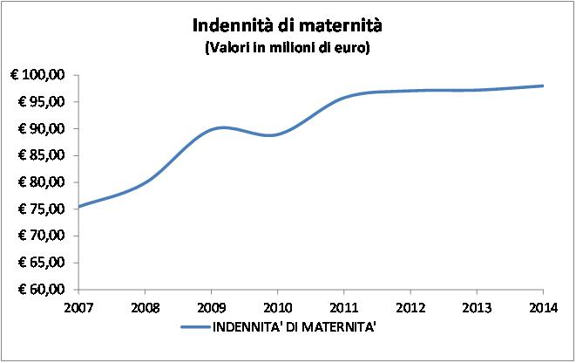
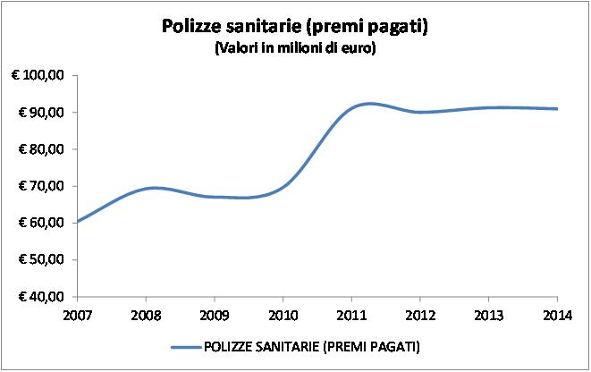
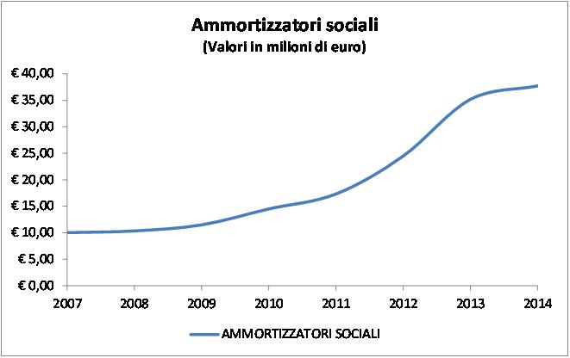
The Jobs Act for autonomous workers and the first pillars funds for professionals in Italy. The role of the Italian Casse di Previdenza in a new subsidiary-based welfare system
An emergent dual track-system: on the one hand, the expansion of a dedicated social security net for autonomous workers; on the other, a new subsidiary relationship between the state and the Casse di Previdenza with the aim of expanding welfare provision for professionals: unemployment benefits, maternity, occupational healthcare, work-life balance, long-term care, active labour market (the Youth Guarantee):

Slide 10
Labour productivity, organizational innovations, new welfare services and investments in the real economy
A subsidiary system to be supported with incentives and tax relief so as to contribute to the expansion of welfare provision and (also) contributing to the economic recovery and investments in the real economy
A new Social Pact: not just a discussion about “regulations” (to access professions, to practice the profession, to enjoy social benefits), but incentives and actions in order to boost labour productivity, to promote internationalisation and labour mobility, access to credit, competitiveness and social inclusion
Concurrently, also investments ...

Slide 11
The role of Casse di Previdenza as “Long-term investors” in a long-term strategy for growth?
The Italian Casse di Previdenza manage an important liquidity that primarily aims to ensure social security provision for professional workers;
These funds also operate as long-term investors, with their own equity in the sectors of reference of their own members;
A new interventionist perspective for the re-launch of public and private investments towards real economy;
Public and private institutional investors (national promotional banks, pension funds, insurance companies, private social security funds) for long-term investments in infrastructures, including social and welfare-related ones;

Slide 12
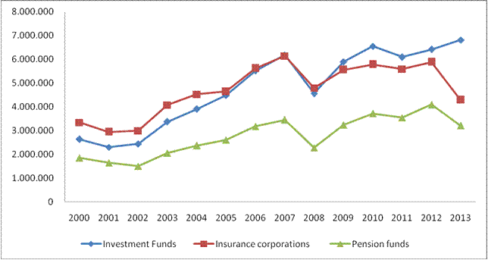
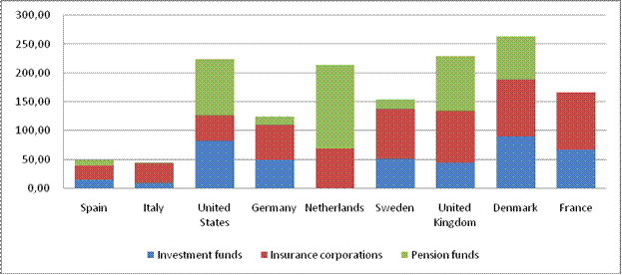
The long-term investors in Europe
Total assets by type of institutional investor in the OECD countries, 2000-2013
Composition of institutional investors in certain European countries, Year 2012, % val. of GDP
Source: Global Pension Statistics, Global Insurance Statistics and Institutional Investors databases
Source: OECD dataset Institutional Investors

Slide 13
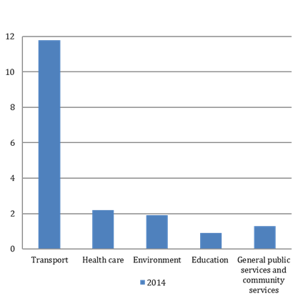
The European strategy: tackling barriers to long-term investments
Investments in PPP’s in Europe per investment sector, Val. billion Euro, Year 2014
The Juncker Plan and the European Fund for Strategic Investments (EFSI)
The 2015 EC Communication on the role of NPBs (National Promotional Banks): CDP; KfW; Caisse des dépôts et consignations etc…
The launch in 2013 of the ELTIF (European Long-Term Investment Funds): New Funds to make long-term investment easier
Within a risk regulated framework, or even when protected by government guarantees, long-term investors can help to boost investments the real economy, including social ones
Source: our elaboration on EPEC database (European PPP Expertise Centre)

Slide 14
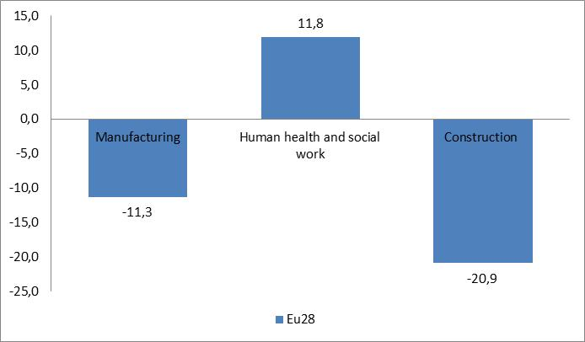
Long-term investments in the real economy: bridges, railways, roads, but also schools, child care services, social and health services, social infrastructure
The liquidity trap in Europe and the need to broaden the pool of private investors to support the economy, as an alternative to the single banking channel
With such high public debts, which will continue to stay high for some time, we need to find different and alternative methods for the large investment plans that Europe needs
Investments in social infrastructure and welfare services can help to achieve two objectives: On the one hand, by guaranteeing tangible medium and long-term returns for private long-term investors and, on the other, by helping to reinforce the welfare supply towards new social risks (child and long-term care, health care services etc..)
jobs in welfare services, also known as white jobs, constitute one of the sectors that have most contributed to job creation in Europe, even during the crisis years;
25 million employees in Europe (+ 9%) between 2008 and 2014
Source: our elaboration on Labour-Force Survey databse

Slide 15
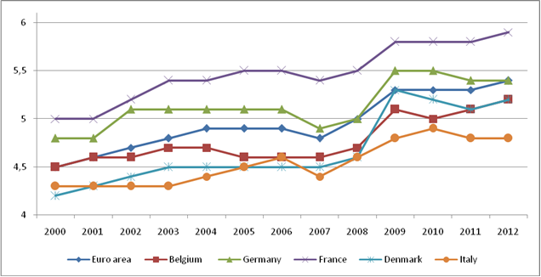
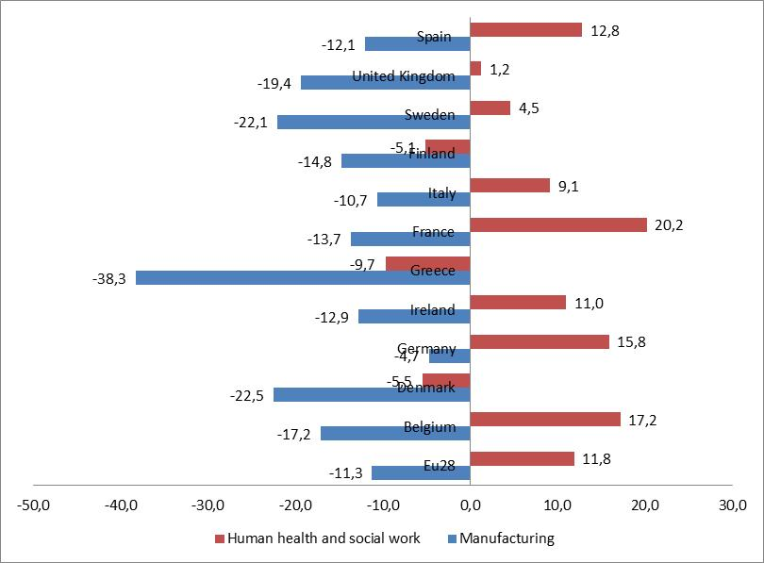
The welfare services as a field of job creation and investments to boost economy
The added value in social and health care services
The employment trends in Europe during the economic crisis, Years 2008-2015, (%)
Source: our elaboration on Eurostat database
Source: our elaboration on Eurostat – Labour Force Survey

